Slide 1
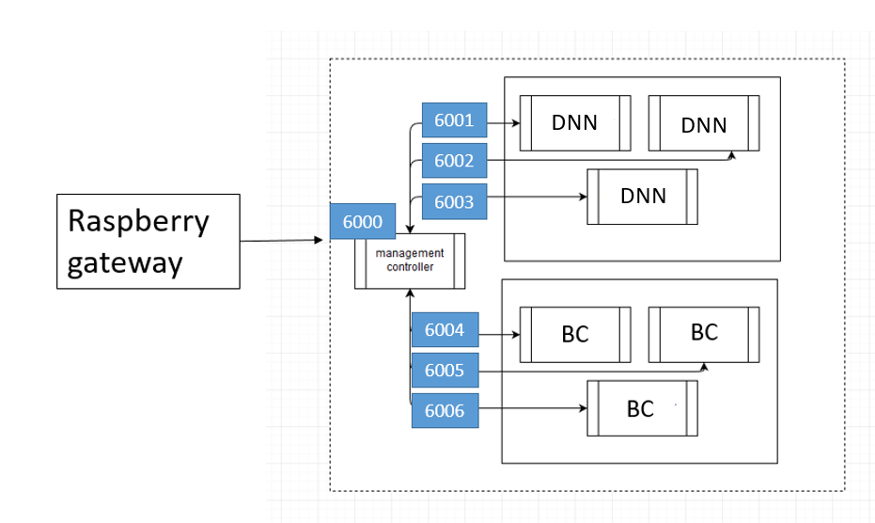
Docker Inner Network

Slide 2
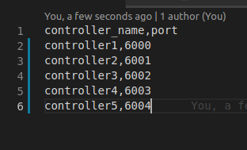
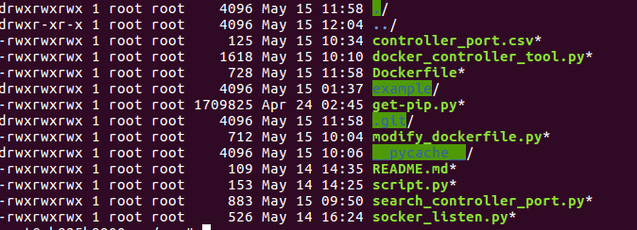
Inner Controller
Continuous monitoring

Slide 3
Future Work
Automatic deployment:
  Let controller being auto-created
  Auto-running socket_listen.py
  Auto-modifying Dockerfile(port)
  Build & Run Dockerfile

Slide 4
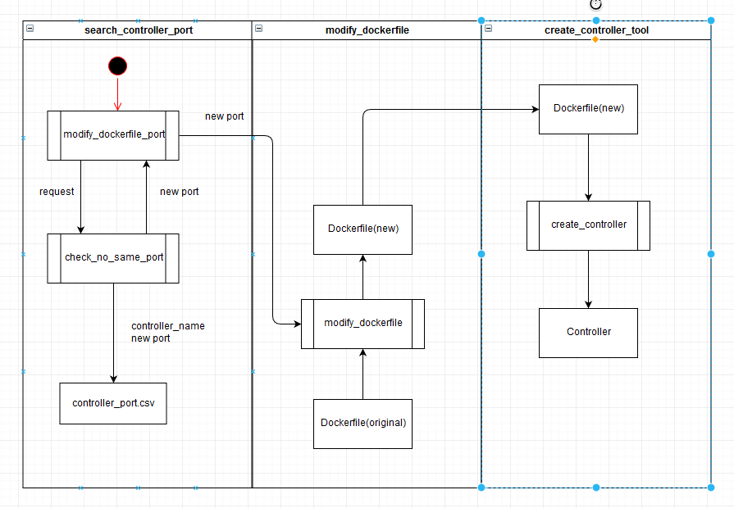
Data Flowing:

Slide 5
6/5
Project Meeting

Slide 6
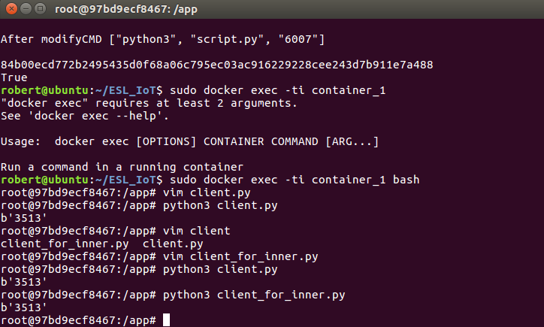
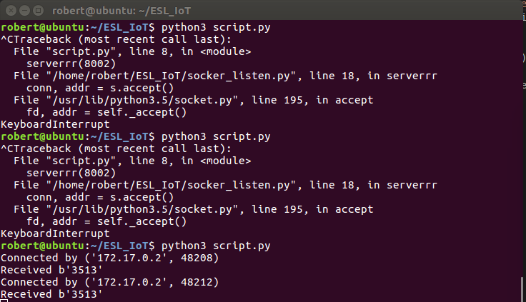
Container To HOST
Container_1
HOST

Slide 7
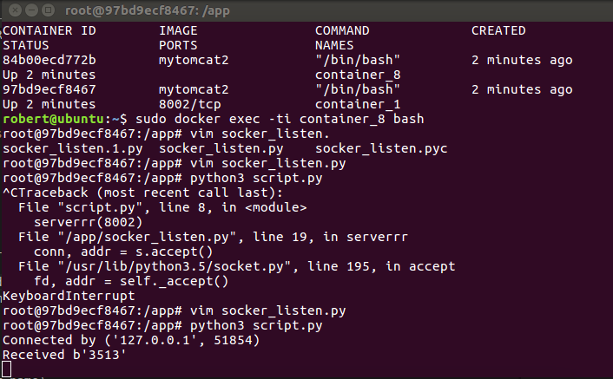
Container_1 To Container_2
Container_2
Container_1

Slide 8
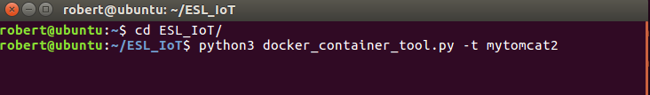
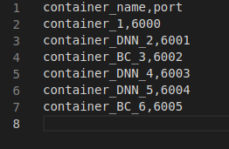
Add new command
1
2

Slide 9
6/12
Project Meeting

Slide 10
Buffer flow
Data_1
DNN
Data
array_1
request
array_2
DNN
array_3
DNN
Mangement container

Slide 11
Input data flow
Input data
check array
Checking array[index] have same or not
check function
Index ++
Yes
No
Buffer_array
  Push function

Slide 12
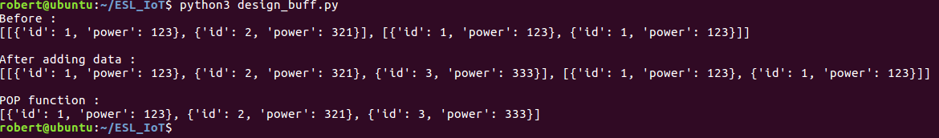
Buffer function
completed function:
  search function
  Pop function
  Push function
  check_buffer_size
  show_buff
Will do function:
  get_request_enter_container

Slide 13
6/26
Project Meeting

Slide 14
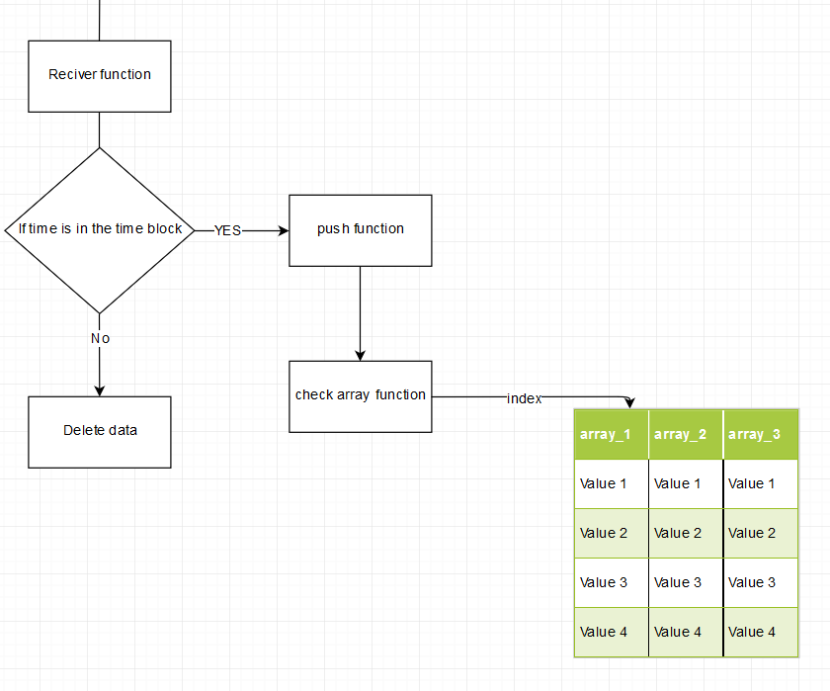
Modify Buff

Slide 15
7/3
Project Meeting

Slide 16
LoRa Buffer
respberry
Receiver
smart meter
package
smart gateway
Payload 1
package
Payload 2
Payload 3
package
queue
Transform into str
analyze

Slide 17
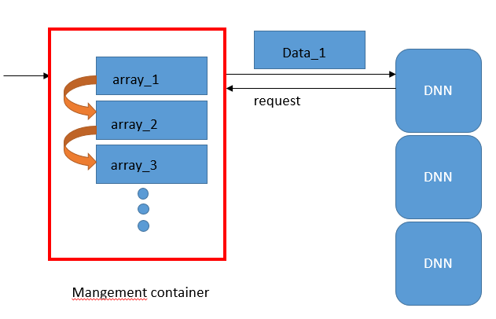
Container Buffer
Transform into str
smart gateway
Management Container

